Slide 1
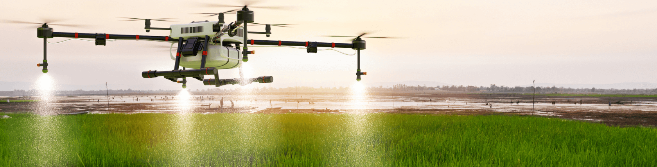
DRONE IN AGRICULTURE
BY KTC HUBLI
Group 5:
Priyanka B
Tanushree
Lata
Kyathi
Laxmi
GUIDED BY
MOHAMMAD TAHIR MIRJI
L2 KTC Hubli ASSIGNMENT FOR
Expert: SABYASACHI B

Slide 2
Content of this Presentation
Here is what you will find in this Presentation:
Introduction
Drone in agriculture
Sensors used in agricultural drones
Advantages
Disadvantages

Slide 3
INTRODUCTION
The introduction of drones in horticulture has revolutionized the way farmers approach crop monitoring, irrigation, and pest control. Drones are equipped with advanced sensors, cameras, and other technology that allow farmers to collect precise data on crop health and growth rates. This data can then be used to optimize crop yields, reduce labor costs, and improve sustainability. Drones are particularly useful in horticulture because they can cover large areas quickly and efficiently. This allows farmers to monitor crops in real-time, which is especially important during critical growth stages. Drones can also be used to apply pesticides and other chemicals in a precise and targeted manner, reducing the amount of chemicals needed and minimizing their impact on the environment.

Slide 4
Drone in Horticulture
Drones can be used in various ways in agriculture, including crop monitoring, irrigation, and pest control. Here are some examples of how drones are used in horticulture:
1.Crop monitoring: Drones equipped with cameras and sensors can capture high-resolution images of crops, which can be used to monitor plant health, detect nutrient deficiencies, and track growth rates. The data collected can help farmers make informed decisions about fertilization, watering, and harvesting.

Slide 5
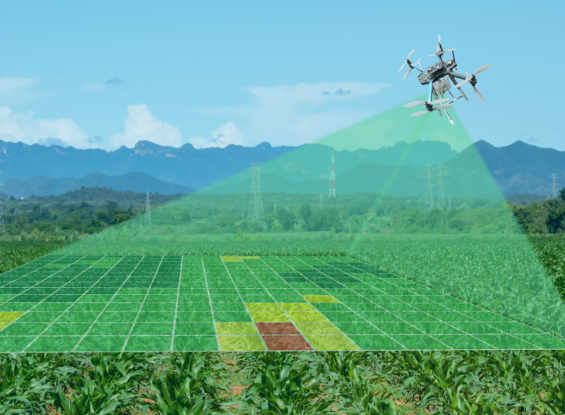
Fig 1 Crop monitoring

Slide 6
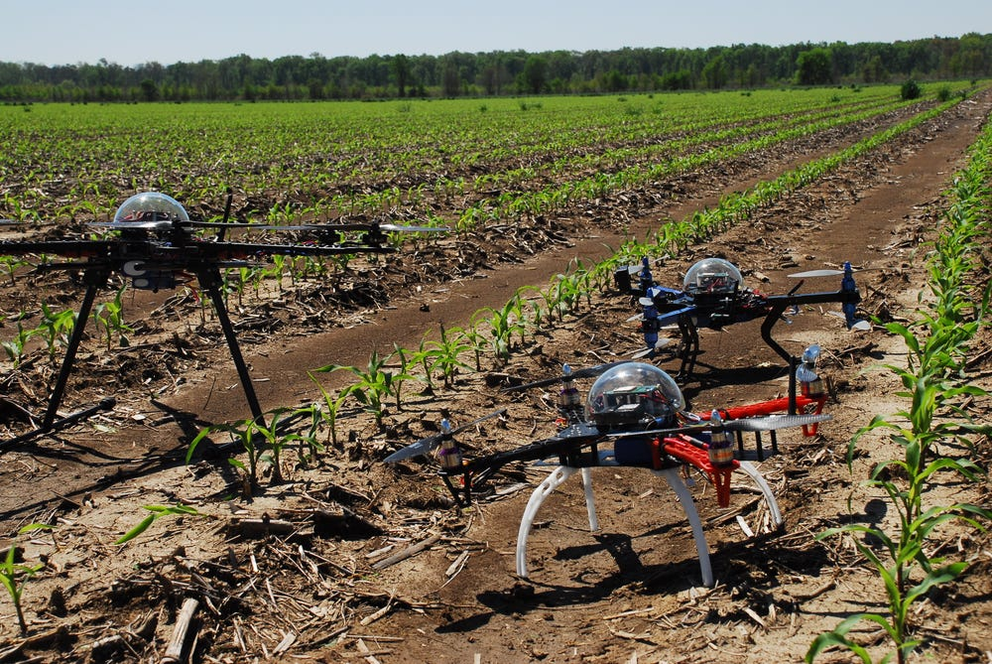
2. Irrigation:
Drones can be used to monitor soil moisture levels and apply water to crops in a precise and efficient manner. This reduces water waste and ensures that crops receive the right amount of water at the right time.
Fig 2 Irrigation

Slide 7
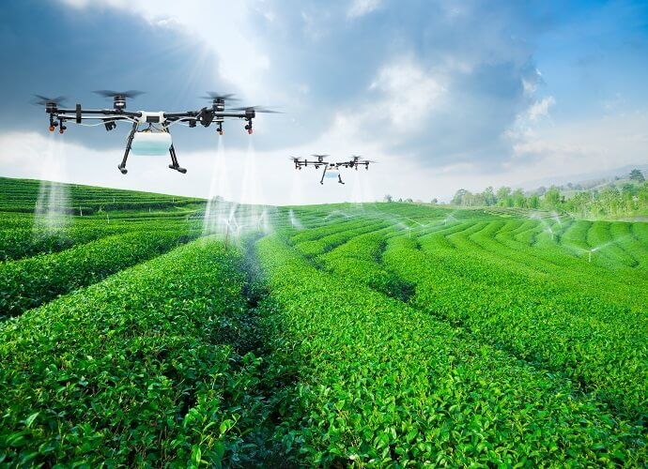
3. Pest control:
Drones can be used to spray crops with pesticides, herbicides, and fungicides, reducing the need for manual spraying and minimizing the exposure of workers to potentially harmful chemicals.
Fig 3 Pest Control

Slide 8
Sensors used in agricultural drones
Agricultural drones are equipped with various sensors that help farmers monitor crops and make data-driven decisions. Here are some of the sensors commonly used in agricultural drones:
1. RGB cameras: These sensors capture high-resolution images of crops, which can be used to monitor plant health, detect nutrient deficiencies, and track growth rates.
2. Multispectral cameras: These sensors capture images in several spectral bands, including red, green, and near-infrared. This data can be used to generate vegetation indices, which can provide insights into crop health, biomass, and water stress.

Slide 9
3. Thermal cameras: These sensors capture images in the infrared spectrum, which can be used to measure crop temperatures and detect stress caused by water, disease, or pest infestations.
4. LiDAR: This technology uses lasers to generate 3D maps of crops, which can be used to measure crop height, density, and biomass.
5.GPS: Global Positioning System (GPS) sensors are used to provide location data for the drone, which is used to create high-precision maps of crop fields.
6. Weather sensors: These sensors measure environmental variables such as temperature, humidity, and wind speed, which can be used to predict crop growth and help farmers make informed decisions about irrigation and pest control.

Slide 10
Advantages
Agricultural drones offer several advantages over traditional farming methods, including:
1. Improved Efficiency: Drones can cover large areas quickly and efficiently, allowing farmers to monitor crops and livestock more frequently and accurately. This can lead to improved yields, reduced labor costs, and increased profitability.
2.Precision Agriculture: Drones can be used to create high-precision maps of crop fields, which can help farmers optimize the use of water, fertilizer, and pesticides. This approach can reduce costs and environmental impact while improving crop yields.

Slide 11
3. Reduced Risk: Drones can be used to monitor crops and livestock in hazardous or hard-to-reach areas, reducing the risk of injury to workers.
4. Better Data Collection: Drones equipped with sensors can collect data on crop health, growth rates, and environmental conditions, providing farmers with more accurate and timely information to make data-driven decisions.
5. Improved Sustainability: By reducing the use of water, fertilizer, and pesticides, drones can help farmers promote sustainable agriculture and reduce the impact on the environment.
6. Time Savings: Drones can cover large areas quickly, reducing the amount of time farmers need to spend on manual crop monitoring and data collection.

Slide 12
Disadvantages
While agricultural drones offer several advantages, there are also some potential disadvantages that farmers should consider, including:
1. High Costs: Agricultural drones can be expensive to purchase and maintain, particularly for smaller farms or farmers who are just starting out.
2. Limited Battery Life: Drones typically have limited battery life, which can restrict the amount of time they can be used for crop monitoring and data collection. This may require farmers to purchase additional batteries or limit the areas that they can cover.
3. Regulatory Restrictions: The use of drones in agriculture is subject to regulations by national and local authorities.

Slide 13
4. Technical Complexity: Operating and maintaining drones requires specialized training and expertise, which may be challenging for some farmers to acquire.
5. Weather Conditions: Drones may not be able to operate in adverse weather conditions such as high winds, rain, or extreme temperatures. This can limit their usefulness during certain times of the year or in certain regions.
6. Limited Payload Capacity: Drones have limited payload capacity, which can restrict the amount of equipment and sensors that can be carried. This can limit their usefulness for certain applications such as large-scale spraying or carrying heavy equipment.

Slide 14
CONCLUSION
In conclusion, the use of agricultural drones has the potential to revolutionize the way farmers monitor and manage their crops and livestock. Drones offer numerous advantages, including improved efficiency, precision agriculture, reduced risk, better data collection, improved sustainability, and time savings. However, there are also potential disadvantages, such as high costs, limited battery life, regulatory restrictions. Ultimately, the decision to adopt agricultural drones will depend on a variety of factors, including the size and needs of the farm, available resources, and the regulatory environment.

Slide 15
THANK YOU

